Slide 1

PMLA
2012
PML Amendment Act
2012
Finance Act 2, 2019

Slide 2
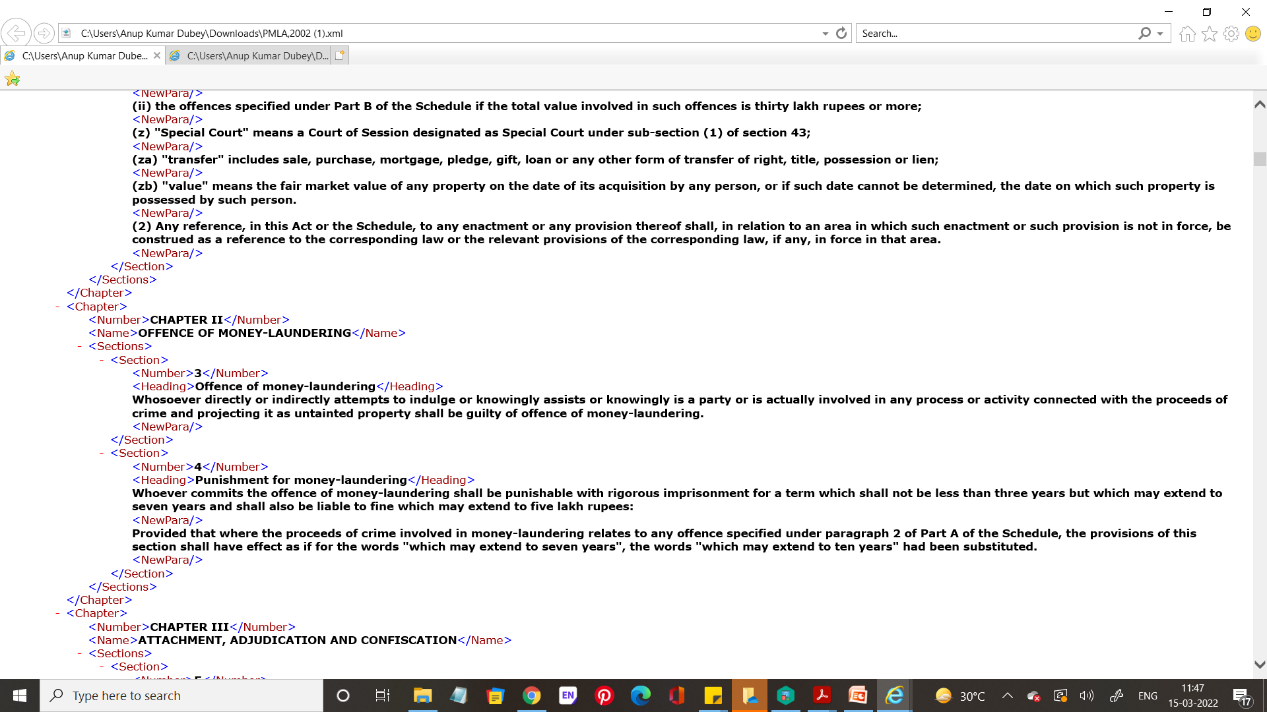
Section 3 PMLA XML

Slide 3
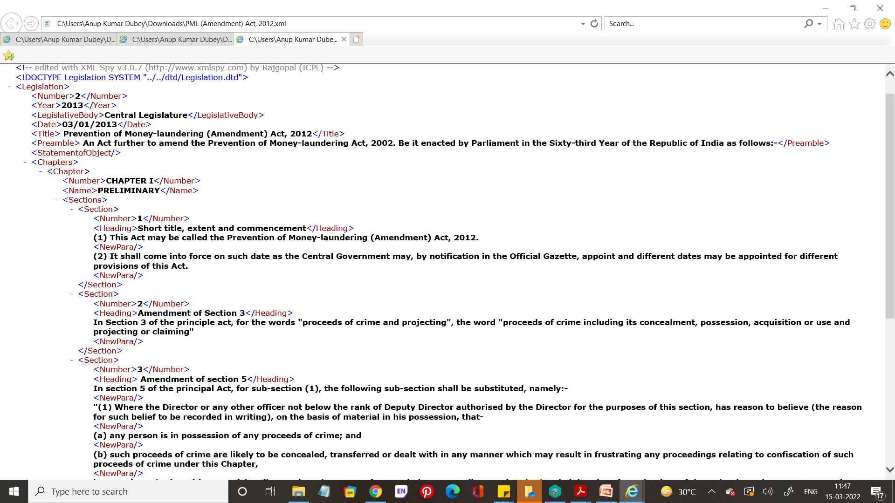
Section 3 Amendment – PML Amendment Act 2012 XML

Slide 4
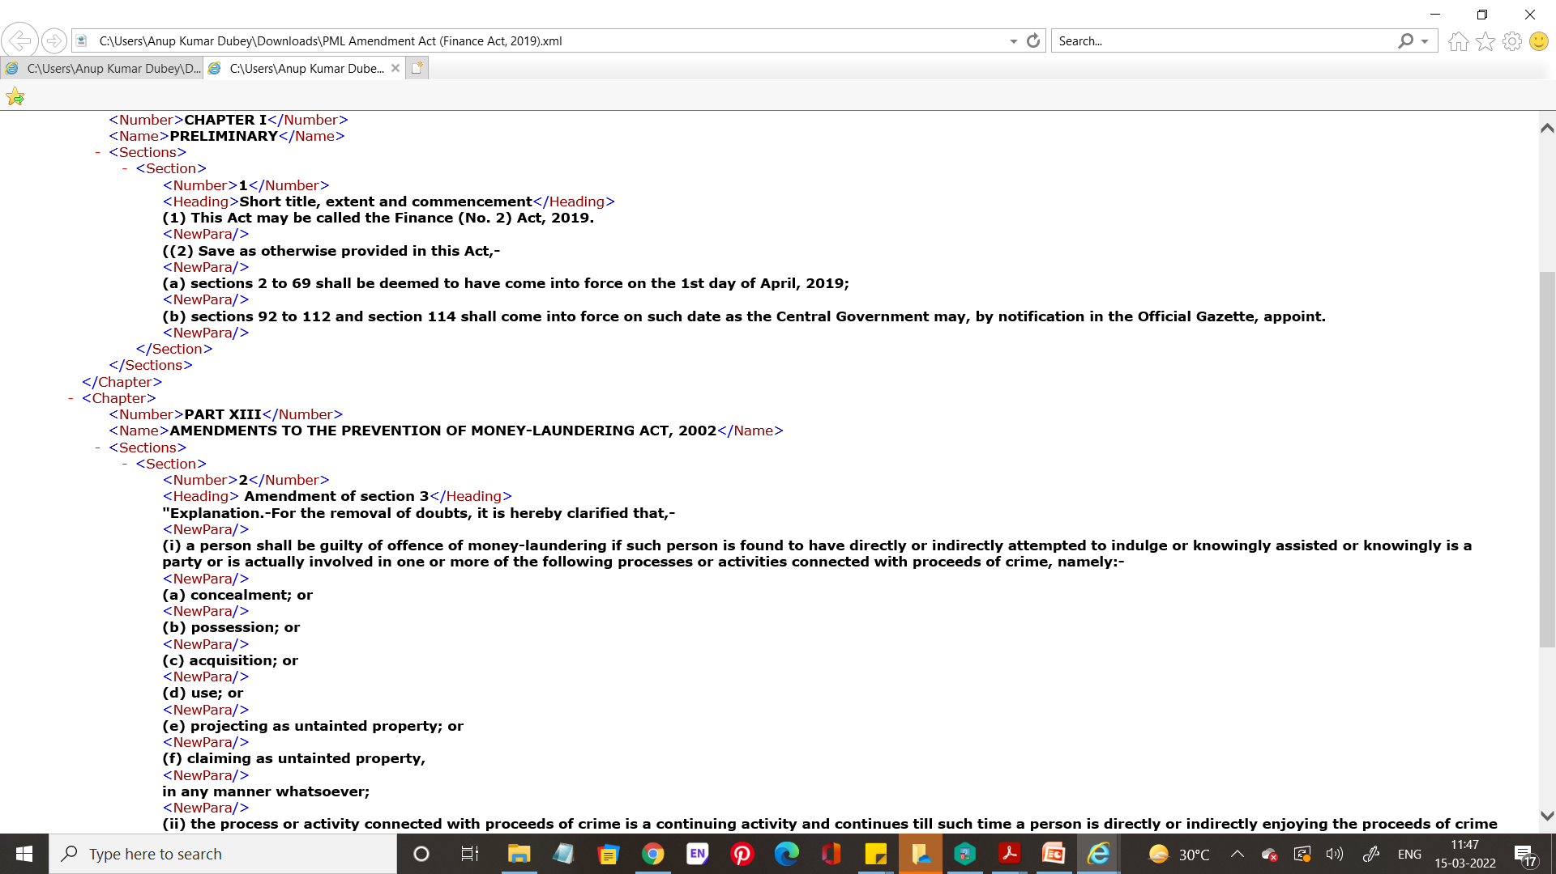
Section 3 Amendment – Finance Act 2019 XML

Slide 5
Why AKN?
The purpose of Akoma Ntoso is to define an XML representation of the parliamentary, legislative, legal and judiciary documents. The standard captures the universal concepts that are found in this kind of documents.
First very important point, the standard is document-centric. The schema is applicable on each major type of documents in this domain: legislation, debate, judgment,
All Akoma Ntoso documents share the same root element <akomaNtoso>, under which the specific document type is selected.

Slide 6
Why AKN?
In Akoma Ntoso, all document types share the same partitions of document namely coverPage, preface, preamble, conclusions… Not all are mandatory.
The only part that is more specific is the main content as its structure varies: a hierarchical structure for act or bill (called <body>), an open structure for doc (called <mainBody>)
A special kind of document is the collection document that may contain one or more AKN documentType (including other collections). The <documentCollection> is the generic type for document that is a collection of documents.

Slide 7
Link for the full document - https://unsceb-hlcm.github.io/part1/index-13.html
Akoma Ntoso uses Internationalized Resource Identifiers (IRIs) as standard mechanisms for referring to documents, languages and concepts on the World Wide Web. A good IRI also has an identification purpose, i.e. it provides a way to universally refer to that resource in a manner that does not change with time, computer systems or software versions. Akoma Ntoso gives a lot of importance to IRIs, and provides rules to systematically specify IRIs for all documents, concepts of the ontology, and even for the markup language itself.

Slide 8
How to utilise, modify, build upon AKN?
Analyse AKN elements
Understand the Description and Scope of AKN elements
Understand the needs of Indian Legislative Markup
AKN elements in context of the ILM needs
Taking cues from European Union’s adoption and improvisation of AKN for EU Legislations

Slide 9
Akoma Ntoso uses patterns to create categories of content to make its schema more modular, flexible, and understandable to users. It uses six families of elements that share the same conceptual organization

Slide 10
Analyse AKN Elements
The markers: markers are content-less elements placed inside the document. Inside the content, they are meaningful for their position, their names and their attributes. Metadata are also markers.
The inlines: an inline element is an element to identify a text fragment as relevant for some reason. (semantic or presentation)
The blocks: a block is a container of text or inlines.
The subFlow: a subFlow element is an element placed within a mixed content element to identify a completely separate context that, for any reason, appears within the flow of the text, but does not belong to it or does not follow its rules.
The containers: containers are sequences of specific elements, some of which can be optional. The shared characteristic of containers is that no text is allowed directly inside them, but only a collection of other elements.
The hierarchy: a hierarchy is a set of sections nested to an arbitrary depth, usually provided with title and numbering. No text is allowed directly inside the hierarchy, but only within a block element that is contained within a container element (not considering, of course, titles and numbering). Akoma Ntoso uses only one hierarchy, with predefined names and no constraints on their order or systematic layering.
Therefore, only elements that are inline or block can contain textual content.

Slide 11
Refer to PDF Files Sent
PART 1. AKN4EU GUIDELINES AND MODELLING
PART 2 – Document types
PART 3. Correspondence between CoV 4.0 and AKN4EU 4.0 Baseline
PART 4. AKN4EU 4.0 Baseline -References

Slide 12
